Slide 1
Capitalized Cost

Slide 2
CAPITALIZED COST CALCULATION AND ANALYSIS
Capitalized cost (CC) is the present worth of an alternative that will last "forever.“
Public sector projects such as bridges, dams, irrigation systems, and railroads fall into this category.

Slide 3
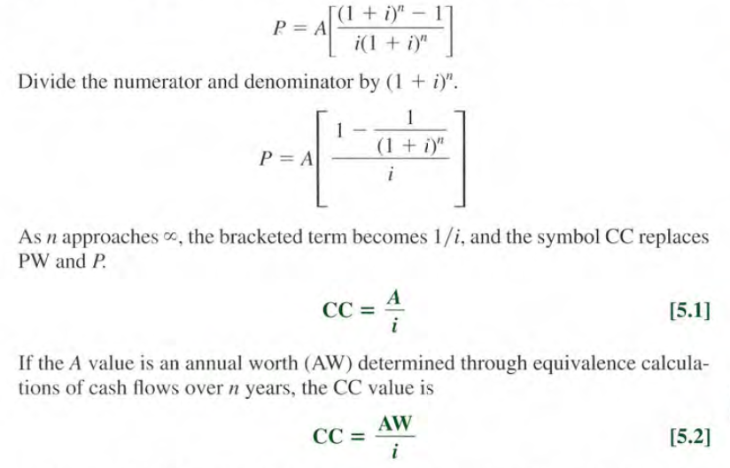

Formula to calculate Capitalized Cost
The formula to calculate CC is derived from the relation
P = A(P / A , i , n), where n = $∞$.

Slide 4


Mathematically, the amount A of new money generated each consecutive interest period for an infinite number of periods is,
A= Pi = CC(i)

Slide 5
The cash flows (costs or receipts) in a capitalized cost calculation are usually of two types: recurring, also called periodic, and nonrecurring.
An annual operating cost of $50,000 and a rework cost estimated at $40,000 every 12 years are examples of recurring cash flows.
Examples of nonrecurring cash flows are the initial investment amount in year 0 and one-time cash flow estimates at future times, for example, $500,000 in technology calibration and upgradation.

Slide 6
Procedure
Draw a cash flow diagram showing all nonrecurring (one-time) cash flows and at least two cycles of all recurring (periodic) cash flows.
Find the present worth of all nonrecurring amounts. This is their CC value.
Find the equivalent uniform annual worth (A value) through one life cycle of all recurring amounts. This is the same value in all succeeding life cycles.
Add this to all other uniform amounts occurring in years 1 through infinity and the result is the total equivalent uniform annual worth (AW).
Divide the AW obtained in step 4 by the interest rate i to obtain a CC value.
Add the CC values obtained in steps 2 and 5.

Slide 7
Solved Problems
An engineering school has just completed a new engineering complex worth $50 million. A campaign targeting alumni is planned to raise funds for future maintenance costs, which are estimated at $2 million per year. Any unforeseen costs above $2 million per year would be obtained by raising tuition. Assuming that the school can create a trust fund that earns 8% interest annually, how much has to be raised now to cover the perpetual string of $2 million in annual costs?
Soln:
Given A= $ 2 million , i= 8% and N = ∞
Find : CE (8%)
The Capitalized cost equation is
CE (i) = A/i CE(8%) = $ 2,000,000 / 0.08 = $ 25,000,000

Slide 8
Example 1:
The property appraisal district for Marin County has just installed new software to track residential market values for property tax computations. The manager wants to know the total equivalent cost of all future costs incurred when the three county judges agreed to purchase the software system. If the new system will be used for indefinite future, find the equivalent value (a) now and (b) for each year hereafter. The system has an installed cost of $150,000 and an additional cost of $50,000 after 10 years. The annual software maintenance contract cost is $5000 for the first 4 years and $8000 thereafter. In addition, there is expected to be a recurring major upgrade cost of $15,000 every 13 years. Assume that i = 5% per year for county funds.

Slide 9
2. To decrease the costs of operating a lock in a large river, a new system of operation is proposed. The system will cost $8,30,000 to design and build. It is estimated that it will have to be reworked every 20years at a cost of $1,20,000. In addition, an expenditure of $80,000 will have to be made at the end of the fifth year from now for a new type of gear that will not be available until then. Annual operating costs are expected to be $70,000 for the first 15 years and $1,00,000 every year thereafter. Compute the capitalized cost at i=7%.

Slide 10
3. A newly constructed bridge costs $15,00,000. the same bridge is estimated to need renovation every 15years at a cost of $3,00,000. annual repair and maintenance cost are estimated to be $ 1,00,000 per year. If the interest rate is 5%, determine the CC of the bridge.

Slide 11
Two large-scale conduits are under consideration by a large municipal utility district (MUD). The first involves construction of a steel pipeline at a cost of $225 million. Portions of the pipeline will have to be replaced every 40 years at a cost of $50 million. The pumping and other operating costs are expected to be $10 million per year. Alternatively, a gravity flow canal can be constructed at a cost of $350 million. The M&O costs for the canal are expected to be $0.5 million per year. If both conduits are expected to last forever, which should be built at an interest rate of 10% per year?

